Slide 1
Learning Deep Belief Nets
Presented by Kaiqi Zhao

Slide 2
Outlines
What is deep belief nets (DBNs)? Why?
How to learn a DBN?
Fine-tuning of generative/discriminative models

Slide 3
Traditional NN & Belief Net
Traditional Neural Network
Belief Net
output layer
hidden layer 2
hidden layer
hidden layer 1
input layer
visible layer
Learn P(output | input)
Back propagation
Labeled data
Scale
Get stuck in local optima
Learn P(input)
Unsupervised learning
No labels
Multi layers – deep nets
A global configuration on data

Slide 4
Two problems in Belief Net
To compute the model, we need to learn the weights of each units.
To use the model, we need to infer the posterior distribution over the hidden units.

Slide 5

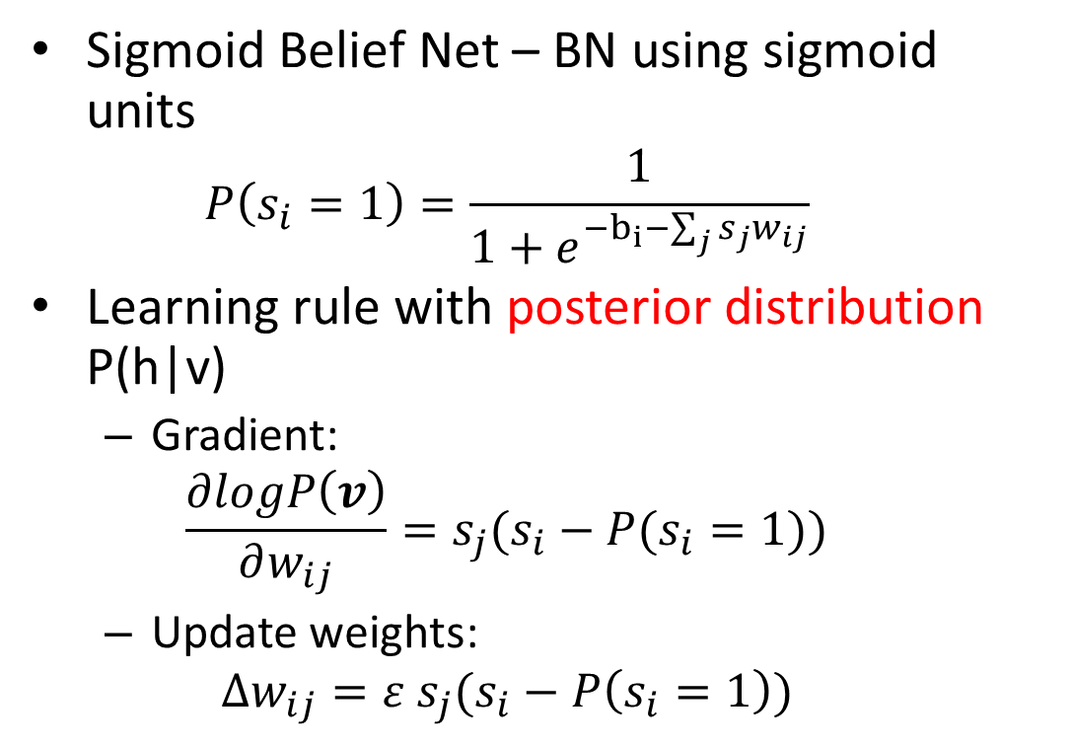
Learning a Sigmoid Belief Net
Sigmoid Belief Net – BN using sigmoid units
$$P\left(s_{i}=1\right)=\frac{1}{1+e^{−b_{i}−\sum_{j}{s_{j}w_{ij}}}}$$
Learning rule with posterior distribution P(h|v)
Gradient:
$$\frac{∂logP\left(v\right)}{∂w_{ij}}=s_{j}(s_{i}−P(s_{i}=1))$$
Update weights:
$$∆w_{ij}=ε s_{j}(s_{i}−P\left(s_{i}=1\right))$$
Sj
$$w_{ij}$$
Si
Learning rate

Slide 6
Learning a Sigmoid Belief Net
It is hard to infer the posterior distribution or even get samples from it
Why? – explaining away (Judea Pearl)
-10
Truck hits house
-10
Earthquake
P(0, 0)=0.0001
P(0, 1)=0.4999
P(1, 0)=0.4999
P(1, 1)=0.0001
20
20
-20
House jumps

Slide 7
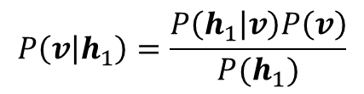
Learning a Sigmoid Belief Net
Illustration of the difficulty in learning SBN
$$P\left(v | h_{1}\right)=\frac{P\left(h_{1} | v\right)P\left(v\right)}{P(h_{1})}$$
h3
h2
To compute W, we need to compute ALL of the configuration of the higher layers!
posterior distribution
prior
h1
posterior distribution
likelihood
W
v

Slide 8
Restricted Boltzmann Machine
Smolensky ,1986
Attributes of RBM:
Undirected & acyclic
One layer of hidden units
No connection between hidden units
Conditionally independent!
hidden layer
visible layer

Slide 9

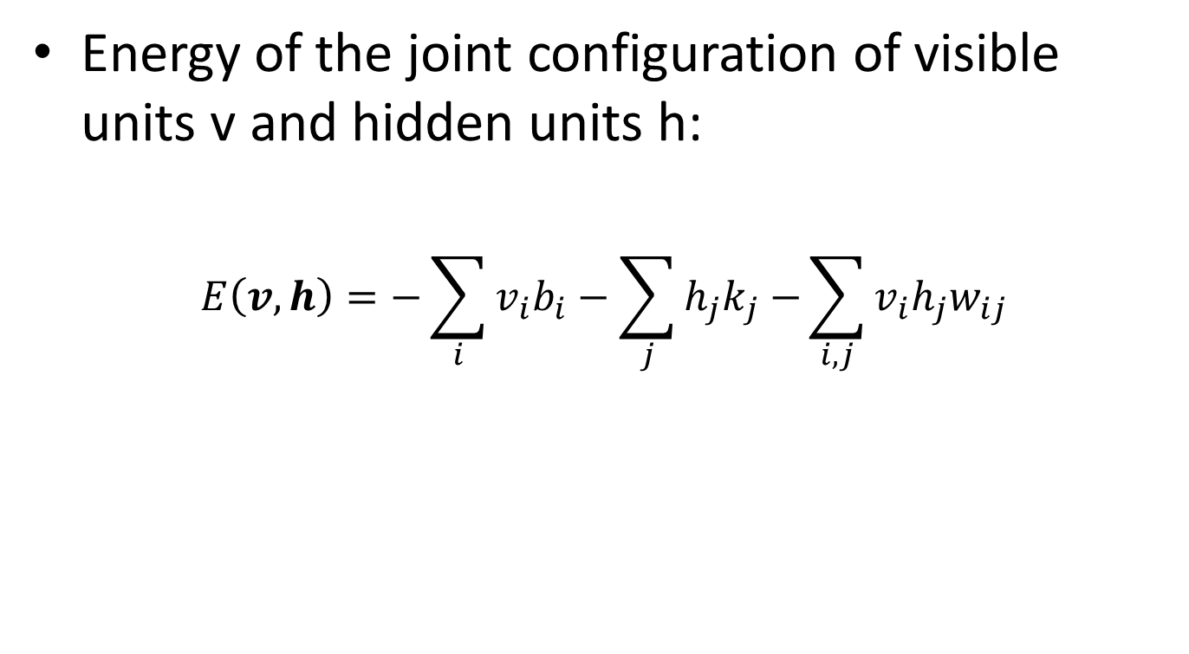
Energy in RBM
Energy of the joint configuration of visible units v and hidden units h:
$$E\left(v,h\right)=−\sum_{i}{v_{i}b_{i}}−\sum_{j}{h_{j}k_{j}−}\sum_{i,j}{v_{i}h_{j}w_{ij}}$$
bias terms
$$−\frac{∂E\left(v,h\right)}{∂w_{ij}}=v_{i}h_{j}$$

Slide 10
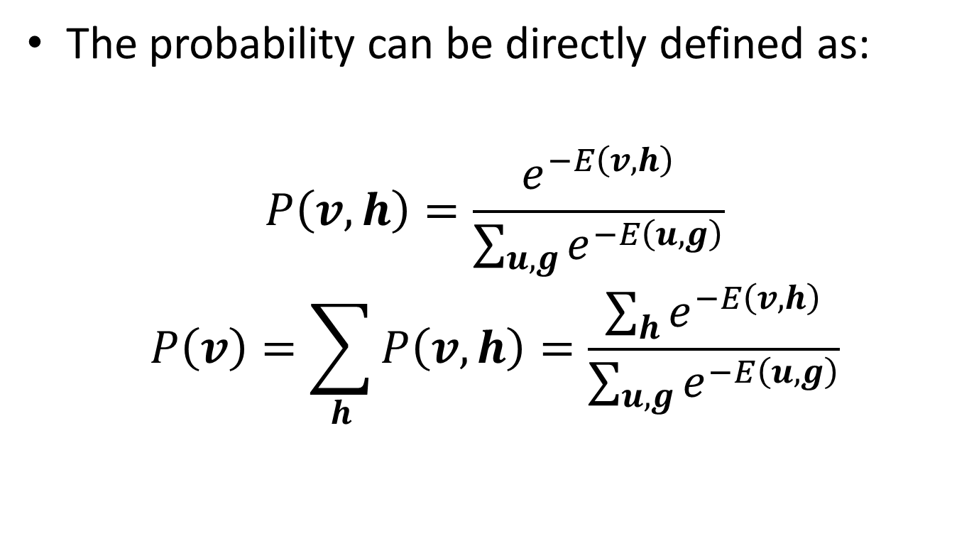
Energy to Probability
The probability can be directly defined as:
$$P\left(v, h\right)=\frac{e^{−E\left(v,h\right)}}{\sum_{u,g}{e^{−E\left(u,g\right)}}}$$
$$P\left(v\right)=\sum_{h}{P\left(v,h\right)}=\frac{\sum_{h}{e^{−E\left(v,h\right)}}}{\sum_{u,g}{e^{−E\left(u,g\right)}}}$$

Slide 11
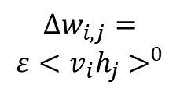


Learning a RBM
Maximum likelihood with Gibbs sampling:
$$\frac{∂logP\left(v\right)}{∂w_{ij}}=<v_{i}h_{j}>^{0}−<v_{i}h_{j}>^{1} \\ +<v_{i}h_{j}>^{1}−<v_{i}h_{j}>^{2} ……−<v_{i}h_{j}>^{∞} \\ =<v_{i}h_{j}>^{0}−<v_{i}h_{j}>^{∞}$$
j
j
j
$$∆w_{i,j}=$$
$$ε<v_{i}h_{j}>^{0}$$
… …
$$<v_{i}h_{j}>^{∞}$$
i
i
i
Start with single visible vector
Update hidden units in parallel and then update visible units in parallel
Contrastive Divergence Learning (CD)

Slide 12

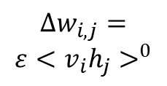
Learning a RBM
A shortcut (Carreira-Perpinan & Hinton, 2005)
j
j
$$∆w_{i,j}=$$
$$ε<v_{i}h_{j}>^{0}$$
$$<v_{i}h_{j}>^{1}$$
i
i
This shortcut is not theoretically correct, it is not following the gradient of maximum likelihood! But it is approximately following another objective function.

Slide 13

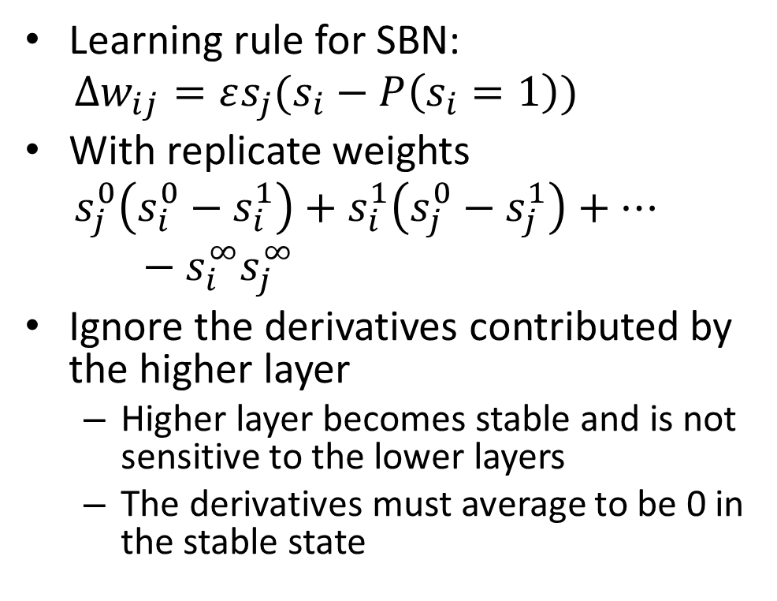


Infinite SBN = RBM
Learning rule for SBN:
$$∆w_{ij}=εs_{j}(s_{i}−P\left(s_{i}=1\right))$$
With replicate weights
$${ s}_{j}^{0}\left(s_{i}^{0}−s_{i}^{1}\right)+s_{i}^{1}\left(s_{j}^{0}−s_{j}^{1}\right)+…−s_{i}^{∞}s_{j}^{∞}$$
Ignore the derivatives contributed by the higher layer
Higher layer becomes stable and is not sensitive to the lower layers
The derivatives must average to be 0 in the stable state
H1
$$W$$
V1
i
$$W^{T}$$
H0
j
$$W$$
V0
i

Slide 14



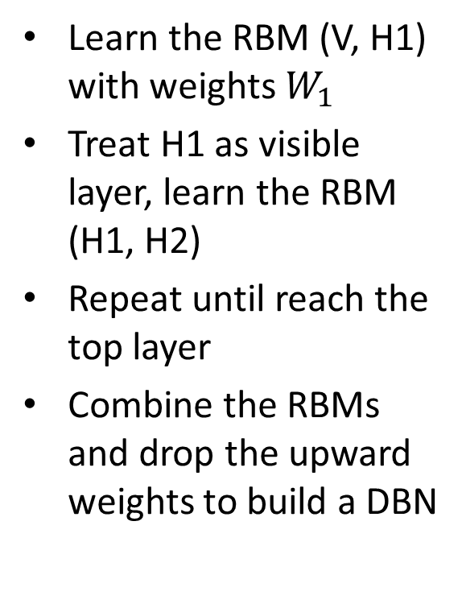



Learning DBN by stacking RBMs
Learn the RBM (V, H1) with weights $W_{1}$
Treat H1 as visible layer, learn the RBM (H1, H2)
Repeat until reach the top layer
Combine the RBMs and drop the upward weights to build a DBN
H3
H3
$$W_{3}$$
3 RBMs to a DBN
$$W_{3}$$
H2
H2
$$W_{2}$$
$$W_{2}$$
H1
H1
$$W_{1}$$
$$W_{1}$$
V
V

Slide 15



Fine-tuning for generation
Contrastive “wake-sleep” algorithm
Bottom-up pass to adjust the top-down weights
Do iterations in the top RBM
Top-down pass to adjust the bottom-up weights
H3
$$W_{3}$$
H2
$$W_{2}$$
H1
$$W_{1}$$
V

Slide 16



Fine-tuning for discrimination
Back prop with pre-training
Treat the DBN as a pre-training to find good features
Add an output layer to the top of the DBN
Do back propagation
O
H3
$$W_{3}$$
H2
$$W_{2}$$
H1
$$W_{1}$$
V

Slide 17
An DBN example
Digit recognition in MINST, Hinton, 2006
The generative model:
Generate both of labels and images
Up-pass from both the image and a state of the labels and do iterations in the top level layer.
2000 neurons
10 label neurons
500 neurons
Supervised learning
500 neurons
28x28 pixel image
Unsupervised learning

Slide 18



An DBN example
Supervised learning
Label units
The discriminative model:
Pre-training on all of the hidden layers
Back propagation
Up-pass from the image and get the labels.
2000 neurons
$$W_{3}$$
500 neurons
$$W_{2}$$
500 neurons
$$W_{1}$$
28x28 pixel image
Unsupervised learning

Slide 19
An DBN example
Results on MINST
Approach | Error rate
Very carefully trained backprop net with one or two hidden layers (Platt; Hinton) | 1.6%
SVM (Decoste & Schoelkopf, 2002) | 1.4%
Generative model of joint density of images and labels (+ generative fine-tuning) | 1.25%
Generative model of unlabeled digits followed by gentle back propagation (Hinton & Salakhutdinov, Science 2006) | 1.15%

Slide 20
Summary
To learn deep belief network:
Learn RBMs layer by layer
Combine the RBMs to construct a DBN and keep the top-down weight as the weight for DBN
Fine-tune the weights with labels
For generative model, use contrastive “wake-sleep”
For discriminative model, use back prop with pre-training

Slide 21
Applications of Deep Learning
DBN can be used in both of classification and regression tasks.
Deep learning techniques are widely used in many fields:
Computer vision & audio
Document models
Recommendation systems

Slide 22
Thank you!

